Slide 1

Generating Random Numbers
COMSATS University Islamabad, Wah Campus

Slide 2
Previous Lecture Outline
Ternary Operators
Switch in C++

Slide 3
Lecture Outline
Generating Random Numbers
Class Activities for Random numbers

Slide 4
Generating Random Numbers
You can use the rand() function to obtain a random integer.
This function returns a random integer between 0 and RAND_MAX. RAND_MAX is platform-dependent constant.
The rand() function’s algorithm uses a value called the seed to control how to generate the numbers. By default, the seed value is 1.
If you change the seed to a different value, the sequence of random numbers will be different. To change the seed, use the srand(seed) function in the cstdlib header file.
srand(time(0)); produces a different output every time you run the program.

Slide 5
Generating random numbers:
To obtain a random integer between 0 and 9, use
rand() % 10
To obtain a random integer between 0 and 99, use
rand() % 100

Slide 6
Activity: Generating Random Numbers
The program may be set up to work as follows:
Step 1: Generate two single-digit integers into number1 and number2.
Step 2: Ask user to enter y if he/she wants to play this game.
Step 3: if user enters yes Prompt the user to answer “What is number1 + number2?”
Step 4: Check the student’s answer and display whether it is correct. If user guess correct answer, display Congratulations otherwise print sorry

Slide 7
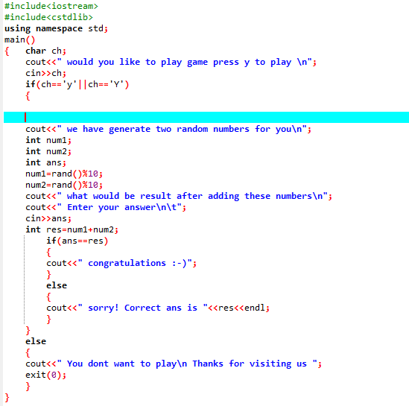

Slide 8
Generating random number between lower and upper bound
Example:
Generating random numbers between 1 and 6 where 1 = minimum value and 6 = maximum value
Formula = (rand()%(maximum value-minimum value+1))+minimum value

Slide 9
Tasks
Which of the following is a possible output from invoking rand()? 323.4, 5, 34, 1, 0.5, 0.234
How do you generate a random integer i such that 0<=i < 20?
How do you generate a random integer i such that 10<=i<=20?
How do you generate a random integer i such that 10 <=i<=50?
Find out what RAND_MAX is on your machine.

Slide 10
Task
Write a program which ask user to generate a random number between 1 and 3 and print apple if random number is 1, prints, grapes if random number is 2 and prints peach if number is 3 (note use switch)

